Slide 1


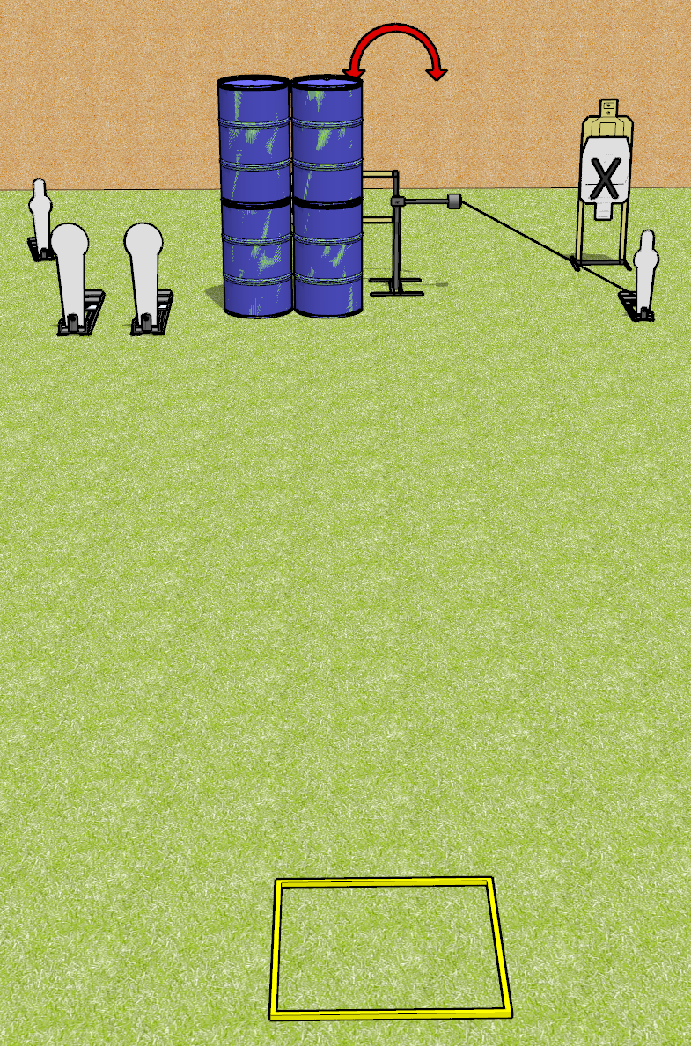
 | Dothan Gun Club – USPSA Match Feel the Need Course Designer : Drew Coleman
Round Count 8 rounds 2 mini poppers, 2 colt poppers 2 USPSA
Equipment List Shooting box Swinger + Activator

Slide 2
Feel the Need
Written Stage Briefing
Feel the Need is an 8 round, 40 point, Comstock speed shoot. There are 2 mini poppers, 2 colt poppers, and 2 USPSA targets. The best 2 hits on paper will score, and steel must fall to score. The start signal is audible.
The swinger is activated by the rightmost mini popper and remains visible at rest.
Handgun start position is in the shooting area, wrists below belt. Handgun is loaded and holstered.
PCC start position is in the shooting area, stock on belt. Loaded carbine is held with both hands, safety on.
On start signal, engage targets from within the shooting area.

Slide 3
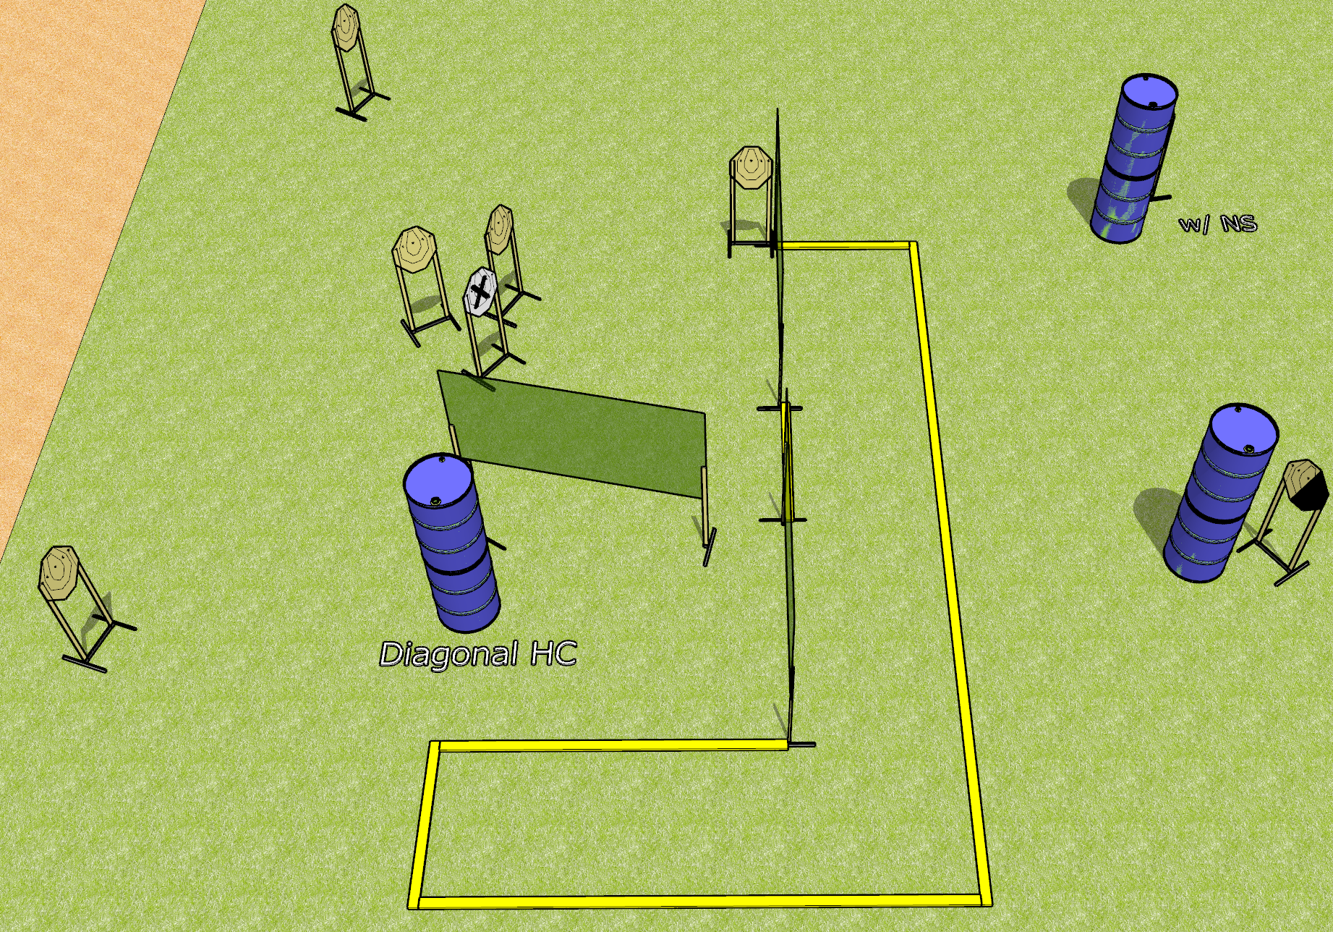
 | Dothan Gun Club – USPSA Match Easy Course Designer : Drew Coleman
Round Count 16 rounds 8 IPSC
Equipment List 6 wall feet 2 medium fault lines 2 diagonal hard cover

Slide 4
Easy
Written Stage Briefing
Easy is a 16 round, 80 point, Comstock course of fire. There are 8 IPSC targets. The best 2 hits on paper will score. The start signal is audible.
Handgun start position is anywhere inside the shooting area, wrists below belt. Handgun is loaded and holstered.
PCC start position is anywhere inside the shooting area, stock on belt. Loaded carbine is held with both hands, safety on.
On start signal, engage targets as they become available from within the shooting area.

Slide 5
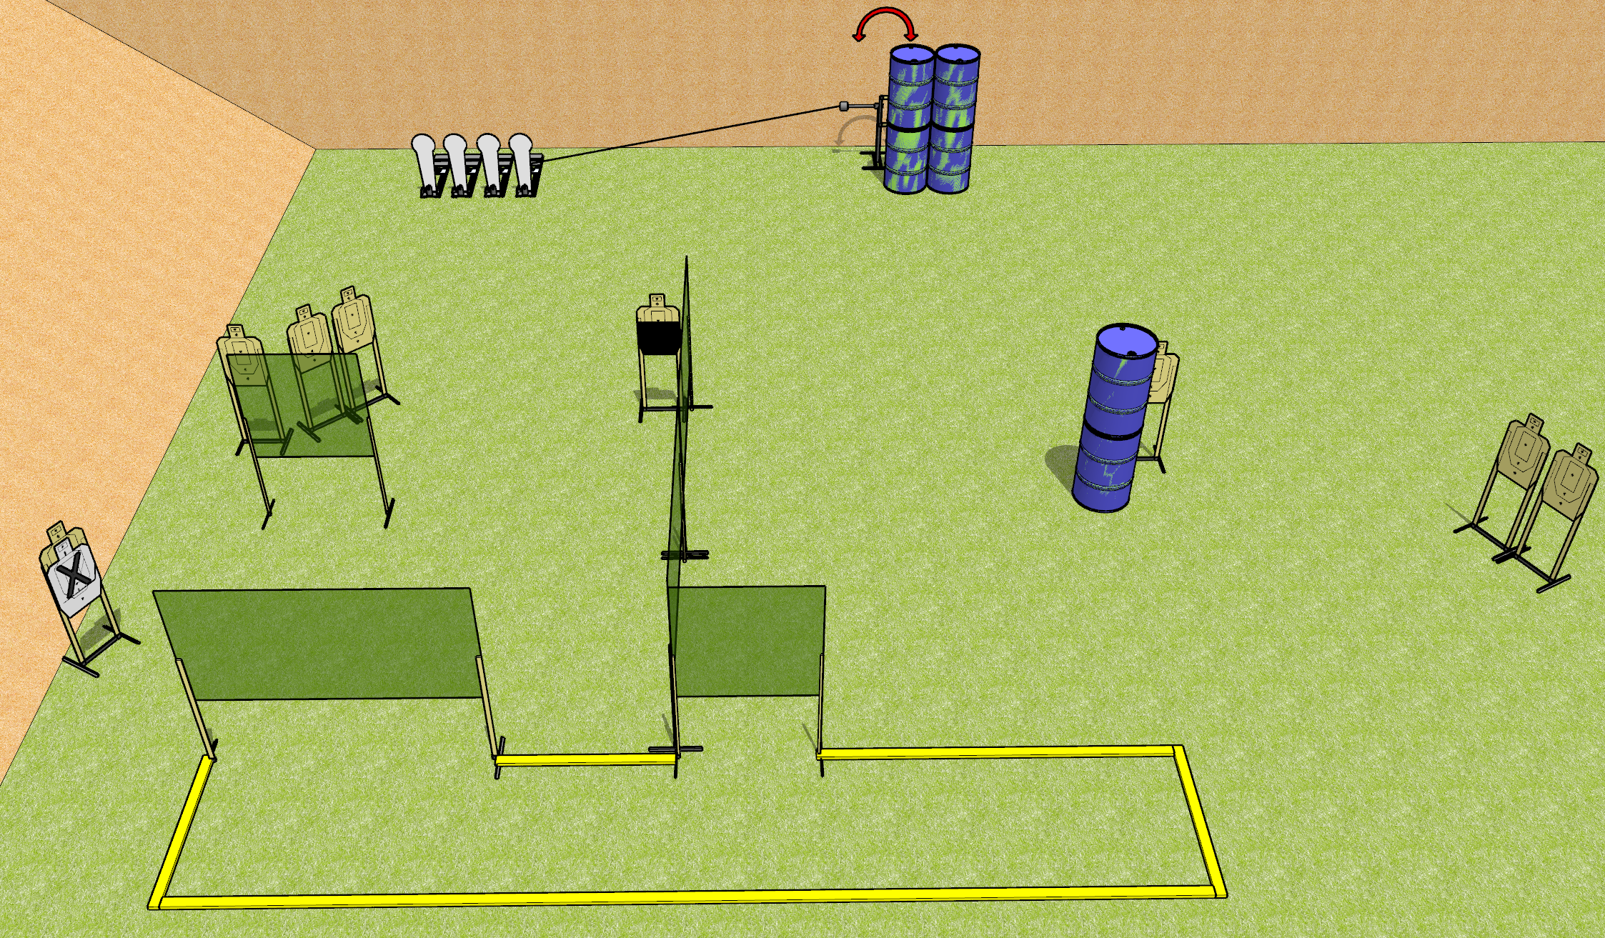
 | Dothan Gun Club – USPSA Match Panic Course Designer : Drew Coleman
Round Count 22 rounds 9 USPSA 4 colt poppers
Equipment List 8 wall feet 1 swinger + activator 1 50%, 1 right diagonal for swinger

Slide 6
Panic
Written Stage Briefing
Panic is a 22 round, 110 point, Comstock course of fire. There are 9 USPSA targets and 4 colt poppers. The best 2 hits on paper will score, and steel must fall to score. The start signal is audible.
The swinger is activated by the rightmost colt popper and remains visible at rest.
Handgun start position is inside the shooting area, wrists below belt. Handgun is loaded and holstered.
PCC start position is inside the shooting area, stock on belt. Loaded carbine is held with both hands, safety on.
On start signal, engage targets as they become available from within the shooting area.

Slide 7
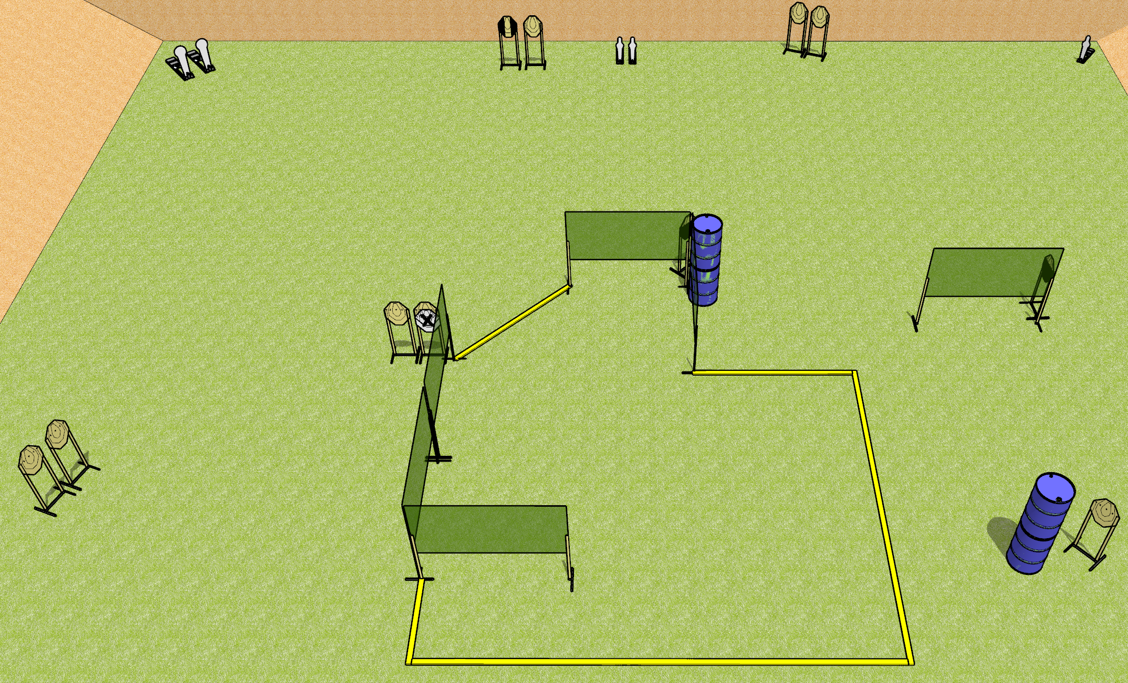
 | Dothan Gun Club – USPSA Match Turtle Season Course Designer : Drew Coleman
Round Count 29 rounds 2 colt poppers, 3 mini poppers 12 IPSC
Equipment List 9 wall feet 1 medium fault line 1 tuxedo, 2 50%

Slide 8
Turtle Season
Written Stage Briefing
Turtle Season is a 29 round, 145 point, Comstock course of fire. There are 12 IPSC targets, 2 colt poppers, and 3 mini poppers. The best 2 hits on paper will score, and steel must fall to score. The start signal is audible.
Handgun start position is anywhere inside the shooting area, wrists below belt. Handgun is loaded and holstered.
PCC start position is anywhere inside the shooting area, stock on belt. Loaded carbine is held with both hands, safety on.
On start signal, engage targets as they become available from within the shooting area.

Slide 9
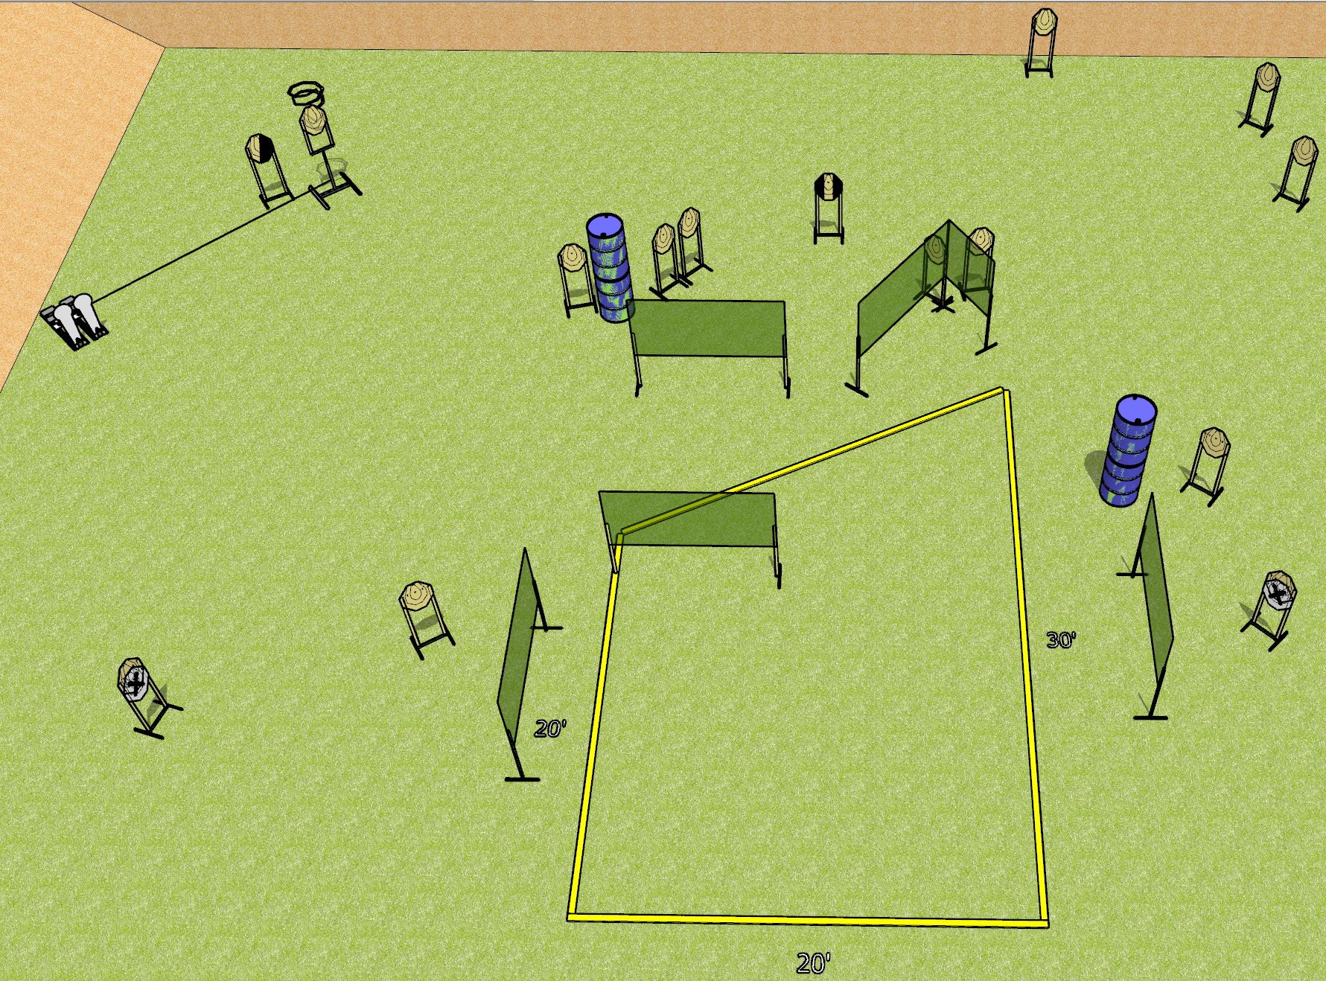
 | Dothan Gun Club – USPSA Match See What Sticks Course Designer : Drew Coleman
Round Count 32 rounds 15 IPSC 2 colt poppers
Equipment List 12 wall feet Drop turner + activator 1 tuxedo, 1 right diagonal

Slide 10
See What Sticks
Written Stage Briefing
See What Sticks is a 32 round, 160 point, Comstock course of fire. There are 15 IPSC targets and 2 colt poppers. The best 2 hits on paper will score, and steel must fall to score.
The drop turner is activated by the right colt popper, and is a disappearing target.
Handgun start position is inside the shooting area, wrists below belt. Handgun is loaded and holstered.
PCC start position is inside the shooting area, stock on belt. Loaded carbine is held with both hands, safety on.
On start signal, engage targets as they become available from within the shooting area.

Slide 11
 | Dothan Gun Club – USPSA Match Shoot House Course Designer : Drew Coleman
Round Count
Equipment List

Slide 12
Shoot House
Written Stage Briefing
Shoot House is a ___ round ____ point Comstock course of fire. There are ___ IPSC targets and ___ poppers. The best 2 hits on paper will score, and steel must fall to score. The start signal is audible.
The swinger is activated by the mini popper and is visible at rest.
All doors must be closed prior to the start signal.
Handgun start position is inside the shooting area, wrists below belt. Handgun is loaded and holstered.
PCC start position is inside the shooting area, stock on belt. Loaded carbine is held with both hands, safety on.
On start signal, engage targets as they become available from within the shooting area.

